Slide 1
Paying for College
Kerry Lubold
Assoc Dir of Fin Aid
SUNY Plattsburgh
www.plattsburgh.edu

Slide 2
1) College Research
Type of Education | Vocational training, 2 year degree, 4 year degree
Academic Programs | Majors, Minors, Concentrations
Academic Enrichment | Study abroad, Assistantships, Internships
Social/Campus Activities | Athletic, Creative, Cultural, Greek
Location | Accessible, Distance from home, Safety
Quality of Education | Faculty excellence, Class size, Support services
Advancement to Career | Graduation rates, Placement rates

Slide 3

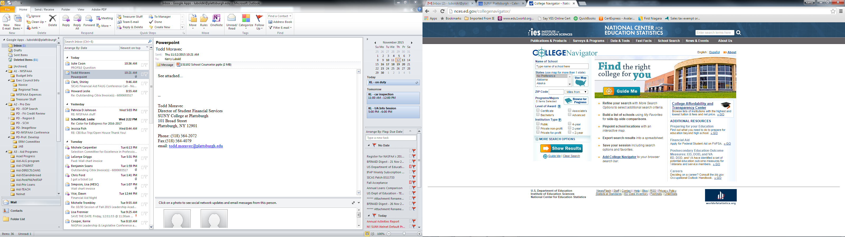

Slide 4
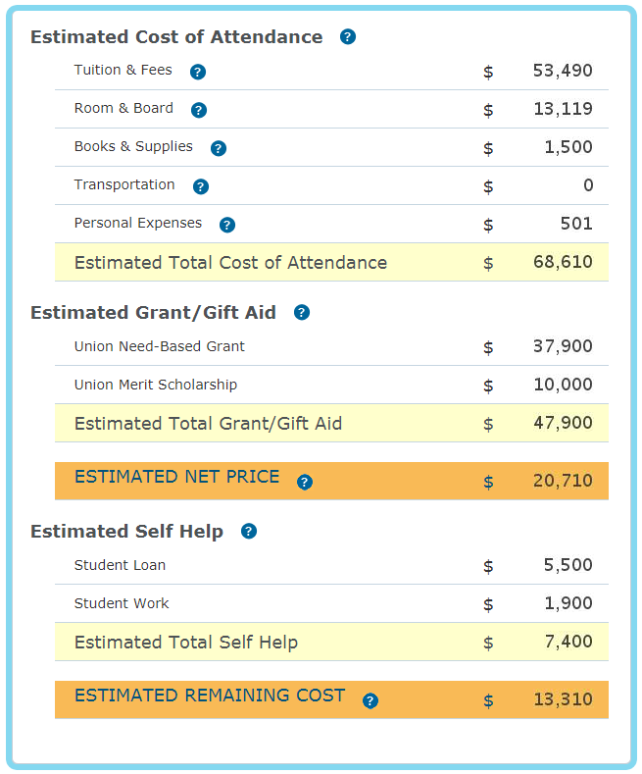
2) Family huddle – how are we paying for college?
What does college cost?
What can we afford to pay?
Is borrowing an option
What other costs are there?
How can we minimize costs?
Explore costs on your college websites
Use the net price calculator

Slide 5
17-18 Direct Costs | Adirondack CC | Plattsburgh | D’Youville | Hartwick
Tuition | 4,392 | 6,670 | 25,240 | 43,312
Fees | 577 | 1,780 | 624 | 1,222
Room | 7,620 | 7,946 | 11,808 | 6,268
Board | 3,590 | 4,532 | 3,570 | 5,82 5
Estimated Total of Direct Costs | $16,179 | $20,928 | $41,242 | $56,627
Indirect Costs (varies student to student)
Books/Supplies $1,220
Transportation $ 800
Personal/Living $1,810
$3,830
Higher cost does
NOT necessarily mean
more costly…

Slide 6
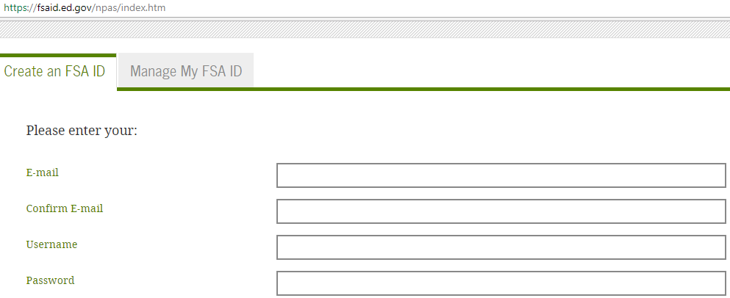
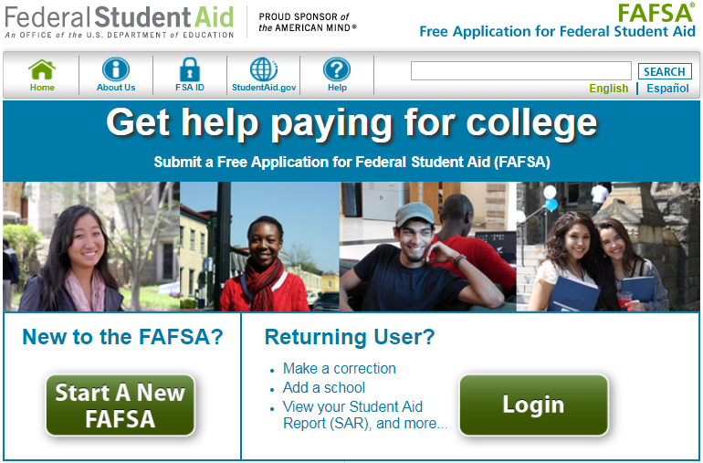
3) Apply for federal aid
Get your FSA ID
at fsaid.ed.gov
- both the student
and one parent
Submit your 18-19 FAFSA
at www.fafsa.gov
- After October 1st
- colleges have deadlines
18-19
FAFSA

Slide 7
The FAFSA
Who is my parent ?
The biological or adoptive parent you live with the most, and that person’s spouse if currently married
Part 1 - Student Demographics
Part 2 - Student Dependency
Part 3 - Parent information, income and assets
Part 4 - Student income and assets
Part 5 – Sign and Submit
The 18-19 FAFSA collects your income from the 2016 tax filing year

Slide 8
4) Apply for NYS Aid
Excelsior Scholarship or
ETA Program:
- info at www.hesc.ny.gov
Basic eligibility requirements:
- NYS resident who is a U.S. citizen or eligible non-citizen
- Fulltime attendance at an approved NYS institution
- Federal AGI for the household is under $110,000 (under $100,000 for the ETA Program)
- Meet degree pursuit requirements
- Execute a service contract committing to NYS residency and employment requirements following college
NYS TAP Grant:
- Follow link from your FAFSA - Or go direct to www.tapweb.org
Basic eligibility requirements:
- NYS resident who is a U.S. citizen or eligible non-citizen
- Fulltime attendance at an approved NYS institution
- NYS taxable income for the household is under $80,000
Learn more and explore
other aid options
at www.hesc.ny.gov

Slide 9
5) Apply for free aid
Guidance Office
College Websites
Around the Web
collegeboard.org petersons.com
fastweb.com scholarships.com
Community & Gov’t Sponsors
Key Club, Boy/Girl Scouts of America, Model UN, 4-H, Football Boosters, National Honor Society, Union Affiliations, Moose Lodge, Kiwanis, American Legion, Church or Synagogue, etc.
Employers (Student & Parents)
tuition reimbursement, interest free loans, scholarships, etc.

Slide 10
www.yourcollegewebsite.edu
how to apply for aid
dates and deadlines
scholarship info
college costs
web portal
CSS PROFILE
profileonline.collegeboard.com
18-19 PROFILE Student Guide
Participating Colleges & Programs

Slide 11
6) respond every time and on time
Communications may occur in paper but more likely will be electronic
Email notifications
Online/web access via student portal
Possible parent and/or guest accounts available
MOST often the communication is sent to the student, not the parent

Slide 12
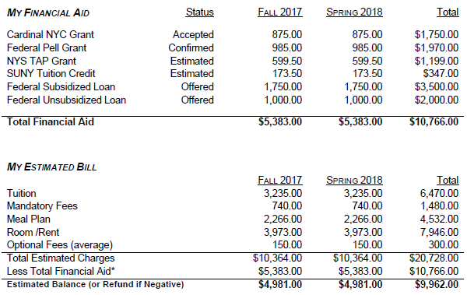
7) Review your award letters
- Lists the types of aid and amounts that you qualify for
- Provides instruction for accepting, declining, or finalizing the awards

Slide 13
8) Consider options for paying
College Costs
Financial Aid
= What You Owe
Payment Plans (college specific)
Personal Resources (savings, investments)
Education Loans (federal or alternative)
- Federal Student Loans
subsidized and unsubsidized
- Federal Parent PLUS Loans
- Alternative Student Loans
thru private banks/lenders

Slide 14

Federal Student Loans at a Glance
Subsidized: no interest while in school
Unsubsidized: interest charged thru entire life of loan
Current Rates: 4.45% interest and 1.069% fees
Base Sub/Unsub Add’l Unsub
1st year undergrad $3,500 + $2,000
2nd year undergrad $4,500 + $2,000
3rd year undergrad $5,500 + $2,000
4th year undergrad $5,500 + $2,000
Federal Parent (PLUS) Loans at a Glance
Eligible Borrower: meet credit, citizenship, non-default criteria
Eligible Amounts: COA – Other Aid = Max PLUS Loan
Current Rates: 7.00% interest and 4.276% fees

Slide 15
9) Communicate your concerns
Special Household & Income Circumstances
Changes in Family Income (e.g. retirement, loss of income)
Change in Marital Status (e.g. widowed, divorced, separated)
Involuntary Dissolution of Family Unit (parental abandonment or separation from parent due to neglect or abuse)
Academic Progress Concerns
Other Challenges
- Academic - Psychological
- Adjustment - Environmental
- Social - Time Management

Slide 16

10) Repeat every year until graduation!
Kerry Lubold, SUNY Plattsburgh
luboldkl@plattsburgh.edu
(518) 564-2072

